Slide 1

MIS 281N
Data Management
Class 3 – Designing a Database
Brad Poynter
Clint Tuttle

Slide 2
Goals for tonight
1st part:
DB overview, Modeling
Short Break
2nd part:
Practice Design/Modeling
Normalization & Practice

Slide 3
Before we begin…
Are there any questions to make note of?

Slide 4
Enterprise application software components
Presentation Layer
Business Logic Layer
Data Layer (aka Persistence Layer)

Slide 5
Compute architecture evolution
Dumb Terminal
Presentation Logic
Presentation Layer/Logic
Presentation Layer/Logic
Mainframe
Business Logic Layer
2-tier client Server
Business Logic Layer
N-tier client Server
Business Logic Layer
Data Layer
Data Layer
Data Layer
Centralized
Web Browser
Presentation Logic
From simple to complex to seemingly simple
Reliability, scale and availability, flexibility, and costs have improved
Cloud Computing
Business Logic Layer
Data Layer
Distributed

Slide 6

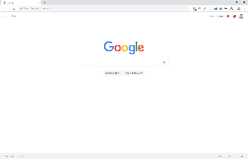


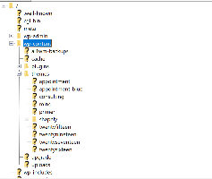
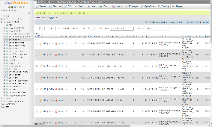


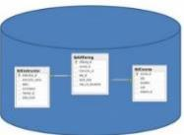
Example: Web Application
How web applications work
Web browser on a client sends a request to a web server.
Web server processes the request.
Web server passes any data requests to the database server.
Database server returns results to web server.
Web server returns a response to the browser.

Slide 7





Common Relational DBMS Brands
Oracle 1979
DB2 1985
SQL Server 1987
PostgreSQL 1986
MySQL 2000
Windows compatible only until recently
Became Open Source in 1994

Slide 8
Database management systems
A relational database management system (DBMS) is software to manage the data layer in enterprise applications
Main purpose is storage and retrieval of data without knowledge of the physical organization of data
Other features include efficiency, data integrity, security, ability to scale to large data volumes and large number of concurrent users
A Relational DBMS must to be ACID
A tomic – Transactions are either committed or rolled back but never saved partially
C onsistent – Provides data integrity. We can trust data is reliable
I solation – Any reads and writes are not impacted by reads/writes of other transactions
D urability – Changes (insert, updated, delete) are permanent

Slide 9
RDBMS provided unified data access
CRM maintains Customer data
Central database
Contains employee,
customer, product,
inventory, order
data
Product Master maintains product details
DBMS
Inventory Management
Data is managed in a central place accessible to many
Central repository of shared data so all agents can access data they need
Data stored in a standardized, convenient form
Requires a Database Management System (DBMS)

Slide 10
Database and data terms
Database
Table
Row (Records)
Column (Fields)
Cell
Primary key
Composite primary key
Index
Foreign key
Data
Data type
Null value
Default value

Slide 11
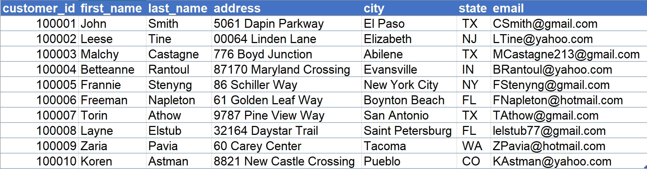
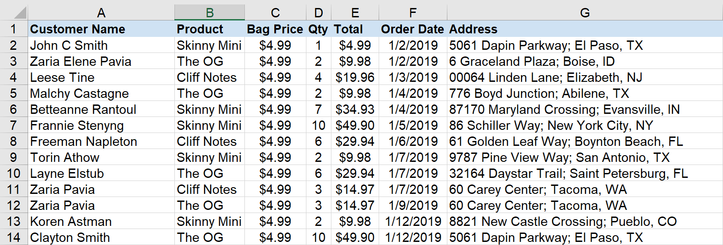
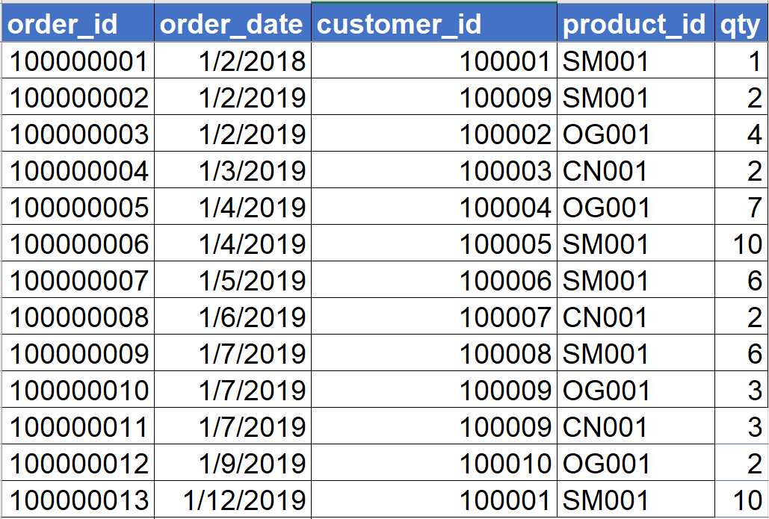

What makes it “relational”?
Customers
Orders
Products
How can we resolve this?

Slide 12
How do we design our database?

Slide 13
Data Modeling
Before creating a database we create a data “model” (i.e. a design)
To create a data model we need to identify all the data that are required and how to best store it
What data elements are required in creating a data model for Hotel Chain Reservation System?

Slide 14
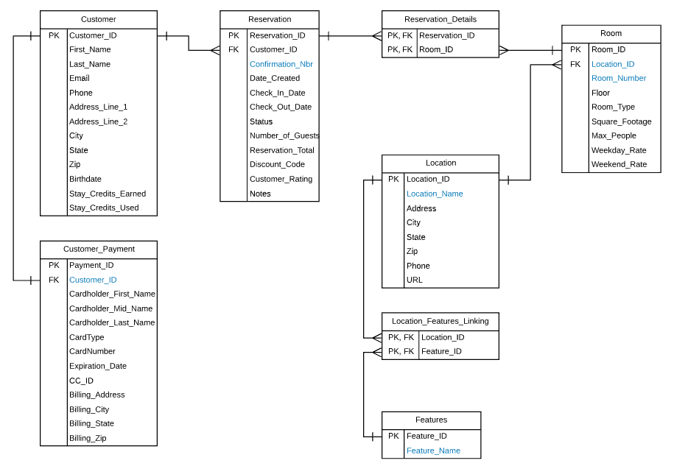
Hotel Reservation System

Slide 15
What is a model?
A model is a ”representation” of the real-world

Slide 16
Designing the data model
Conceptual Model
Logical Model
Physical Model
Non-technical easy to understand statements developed collaboratively that articulate the role of data in the business
Entities and Relationships
Conceptual model translated into entities and relationships using Entity-Relationship modeling tools
Tables, fields, and keys
Conversion of logical data model into definitions of tables and columns (database)
DDL script that builds the out the model

Slide 17
2 approaches to modeling
Top-down Start with high-level conversations with stakeholders to create a conceptual model in simple easy to understand English language statements → main entities & relationships
Bottom-up (follow the 6 rules of design) Start with artifacts, documents, and systems analysis to articulate the conceptual model in simple easy to understand English language statements → tables, fields, and keys
Both approaches should lead to the same place

Slide 18



Home Address
Customer
Important Terms
Entities (typically a table)
Attributes (fields on the table)
How can entities relate?
One-to-one relationship Combine into 1 table
One-to-many relationship Keep these separated into 2 tables
Many-to-many relationship Link these 2 tables with a 3rd linking table
Order
Products
Notes:
Example: Student Org, Org Sponsor, Student Members

Slide 19
Conceptual model – top-down
Accounts payable example
Top-down conversation
What entities are involved to track how much we owe and to who?
How would you get here without knowledge of the AP process?

Slide 20
Conceptual model – bottom-up
Accounts payable example
Bottom-up approach following rules
…

Slide 21
6 basic steps for designing a data structure
Step 1: Identify the data elements
Step 2: Subdivide each element into its smallest useful components
Step 3: Identify the tables and assign columns *
Step 4: Identify (or assign) the primary and foreign keys *
Step 5: Review whether the data structure is normalized
Step 6: Identify the indexes
* Identify entity relationships where possible

Slide 22
Step 1: Identify the data elements
Questions
Which elements are relevant?
Which elements are not relevant?
i.e. we don’t need to store it
What elements are missing that we should store?
Notes:
Which are data elements that are not re

Slide 23
Step 1: Identify the data elements
Data elements on the invoice
Vendor name
Vendor address
Vendor phone number
Vendor fax number
Vendor web address
Invoice number
Invoice date
Invoice terms
Item part number
Item quantity
Item description
Item unit price
Item extension
Vendor sales contact name
Vendor sales contact ext
Vendor AR contact name
Vendor AR contact ext
Invoice total
Notes:
Which are data elements that are not re

Slide 24
Step 2: Subdivide elements into smallest useful components
Vendor name
Vendor address
Vendor phone number
Vendor fax number
Vendor web address
Invoice number
Invoice date
Invoice terms
Item part number
Item quantity
Item description
Item unit price
Item extension
Vendor sales contact name
Vendor sales contact ext
Vendor AR contact name
Vendor AR contact ext
Invoice total
Which should be split up into multiple columns?

Slide 25

What is a reason to sub-divide data elements like Vendor_Sales_Contact_Name?

Slide 26
What is a reason to sub-divide data elements like Vendor_Address?

Slide 27
Step 3: Identify the tables (entities) and columns (attributes)
Sub-divided elements on the invoice
Vendor name
Vendor address
Vendor city
Vendor state
Vendor zip
Vendor phone number
Vendor fax number
Vendor web address
Invoice number
Invoice date
Invoice terms
Item part number
Item quantity
Item description
Item unit price
Item extension
Vendor sales contact name
Vendor sales contact ext
Vendor AR contact name
Vendor AR contact ext
Invoice total

Slide 28
Step 3: Identify the tables (entities) and columns (attributes)
Sub-divided elements on the invoice
Quick discussion as a class
Identify tables.
Can you start to identify entity-to-entity relationships
Identify which columns would go with which table.
i.e. which attributes go with which entity
Vendor name
Vendor address
Vendor city
Vendor state
Vendor zip
Vendor phone number
Vendor fax number
Vendor web address
Invoice number
Invoice date
Invoice terms
Item part number
Item quantity
Item description
Item unit price
Item extension
Vendor sales contact name
Vendor sales contact ext
Vendor AR contact name
Vendor AR contact ext
Invoice total

Slide 29
What are major entities? What about relationships?
Sub-divided elements on the invoice
Vendors
Invoices
Vendor name
Vendor address
Vendor city
Vendor state
Vendor zip
Vendor phone number
Vendor fax number
Vendor web address
Invoice number
Invoice date
Invoice terms
Item part number
Item quantity
Item description
Item unit price
Item extension
Vendor sales contact name
Vendor sales contact ext
Vendor AR contact name
Vendor AR contact ext
Invoice total
Invoices
Items

Slide 30
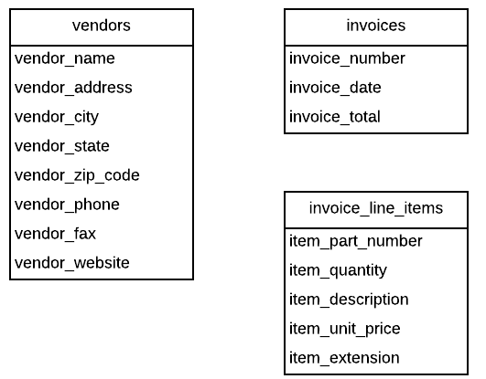
Step 3: Identify the tables (entities) and columns (attributes)
Sub-divided elements on the invoice
Vendor name
Vendor address
Vendor city
Vendor state
Vendor zip
Vendor phone number
Vendor fax number
Vendor web address
Invoice number
Invoice date
Invoice terms
Item part number
Item quantity
Item description
Item unit price
Item extension
Vendor sales contact name
Vendor sales contact ext
Vendor AR contact name
Vendor AR contact ext
Invoice total
What about these?

Slide 31
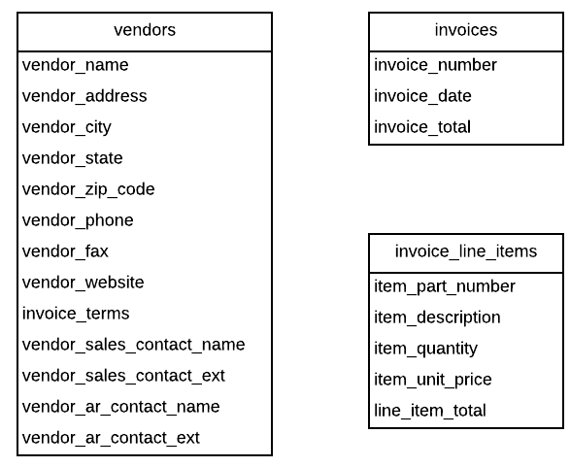
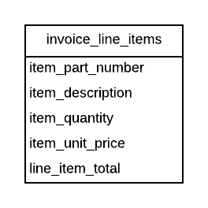
Step 3: Identify the tables (entities) and columns (attributes)
Sub-divided elements on the invoice
Vendor name
Vendor address
Vendor city
Vendor state
Vendor zip
Vendor phone number
Vendor fax number
Vendor web address
Invoice number
Invoice date
Invoice terms
Item part number
Item quantity
Item description
Item unit price
Item extension
Vendor sales contact name
Vendor sales contact ext
Vendor AR contact name
Vendor AR contact ext
Invoice total

Slide 32
6 basic steps for designing a data structure
Step 1: Identify the data elements
Step 2: Subdivide each element into its smallest useful components
Step 3: Identify the tables and assign columns *
Step 4: Identify (or assign) the primary and foreign keys *
Step 5: Review whether the data structure is normalized
Step 6: Identify the indexes
* Identify entity relationships where possible

Slide 33
Now we’re making a detailed design
Conceptual Model
Logical Model
Physical Model
Non-technical easy to understand statements developed collaboratively that articulate the role of data in the business
Entities and Relationships
Conceptual model translated into entities and relationships using Entity-Relationship modeling tools
Tables, fields, and keys
Conversion of logical data model into definitions of tables and columns (database)
DDL script that builds the out the model

Slide 34
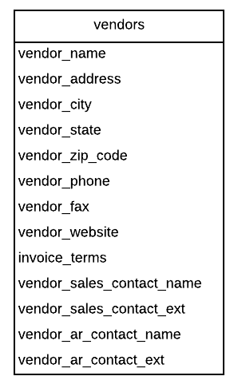
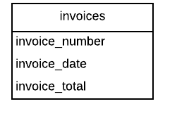
Step 4: Identify (or assign) the Primary and Foreign Keys
What field should be the PK? If you can’t find it, assign one.
Also remember it should be unique and not change

Slide 35
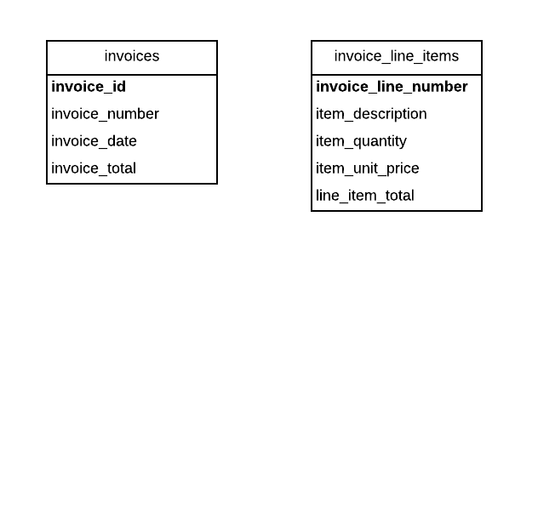
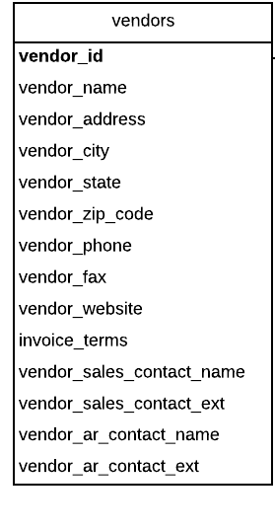
Step 4: Identify the Primary and Foreign Keys
PK
PK
PK

Slide 36
Step 4: Identify the Primary and Foreign Keys
PK
PK
PK

Slide 37
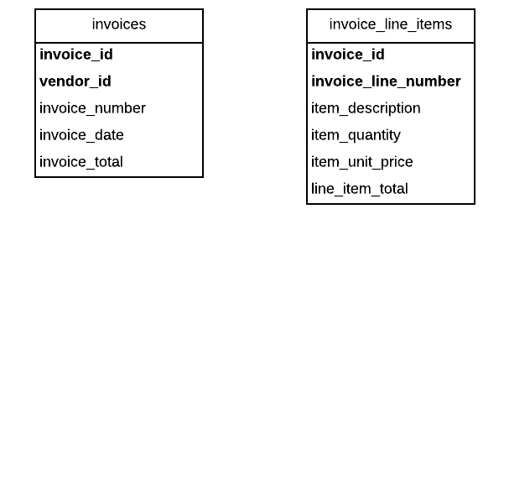
Step 4: Identify the Primary and Foreign Keys
PK
PK
PK
PK
FK
FK
PK

Slide 38
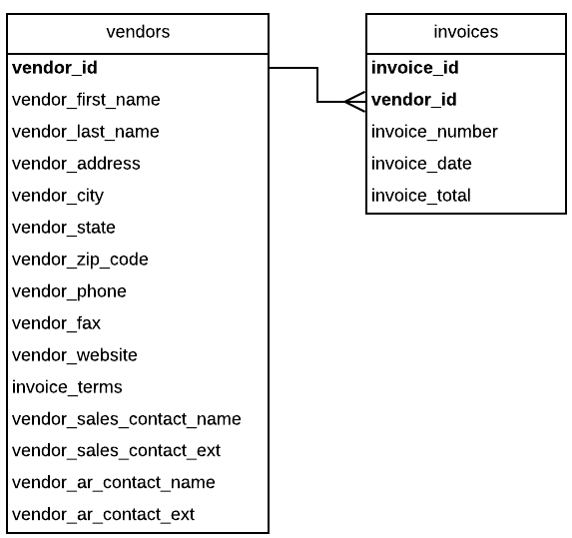
Relational Integrity
Deleting a row from primary key table: If the foreign key table contains one or more rows related to the deleted row
Inserting a row in the foreign key table: If the foreign key value doesn’t have a matching primary key value in the related table
Updating the value of a foreign key: If the new foreign key value doesn’t have a matching primary key value in the related table
Updating the value of a primary key: If the foreign key table contains one or more rows related to the row that’s changed

Slide 39
Relationships & Notations

Slide 40
Types (Cardinality) of Relationships
One to One
One to Many
Many to Many
Zero/One to One
Zero/One to Many

Slide 41
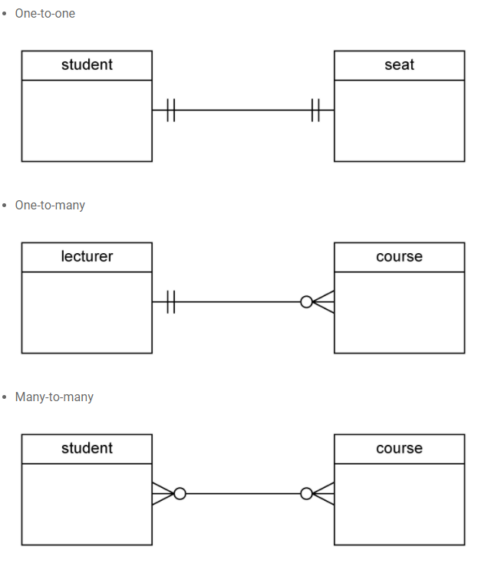
Modeling Notation – Crow’s Foot
Only One (Required)
One (Optional)
One or More (Optional)
One or More (Required)

Slide 42
Practice solo or in small groups

Slide 43
Practice: Design a database for tracking an org’s committees
We need to track our members and the committees they’re on within our organization. Each of our members can belong to any number of committees and that each committee can have any number of members. Also members are always assigned a single role on each committee (e.g Social Chair, Social General). Assume that:
Each individual can only serve one role within a committee and…
That each committee has its own set of specific roles that members can fulfill.
–Org President
Your mission is to create a database design for this described situation. The recommended steps would be to:
Identify data elements & subdivide into useful form. Feel free to make assumptions
Identify the entities (tables) and attributes (columns) for each
Can we identify any entity-to-entity relationships yet?
What are the primary keys, foreign keys, and remaining relationships?

Slide 44
Practice: Design a database for tracking org memberships
Let’s discuss:
What are key entities?
What are data elements?
What are relationships between members and committee?
What do we do with many-to-many relationships in database design?
What are primary keys?
What are foreign keys?
Members
Committees
Roles

Slide 45
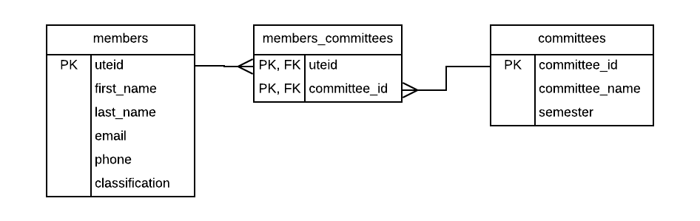
Possible Solution: Org Memberships (w/o roles)

Slide 46
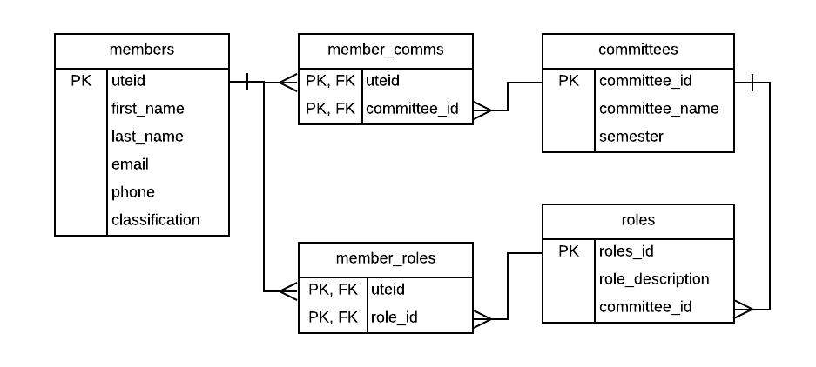
Possible Solution: Org memberships (w/ Roles)
NOTE: This assumes that a committee can have roles setup before we have people join the committee and they are assigned roles.

Slide 47
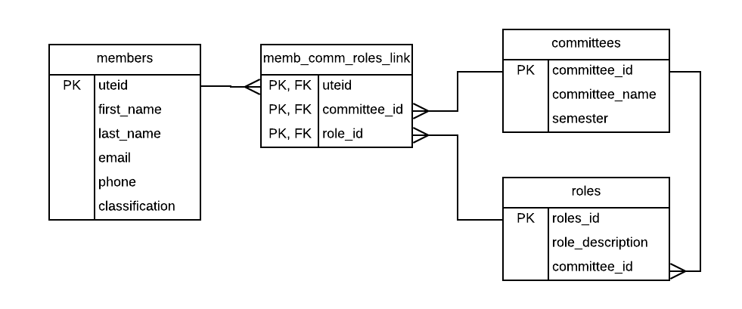
Possible Solution: Org memberships (w/ Roles)
NOTE: This could assume that the committee and role can't exist without a UTEID which maybe isn't true at start of semester. Context is important!

Slide 48

Possible Solution: Org memberships (w/ Roles)
This allows people to join committees without a role

Slide 49
Want more practice?

Slide 50
Conceptual model – top-down
Lawncare company example
Top-down conversation
What entities are involved?

Slide 51
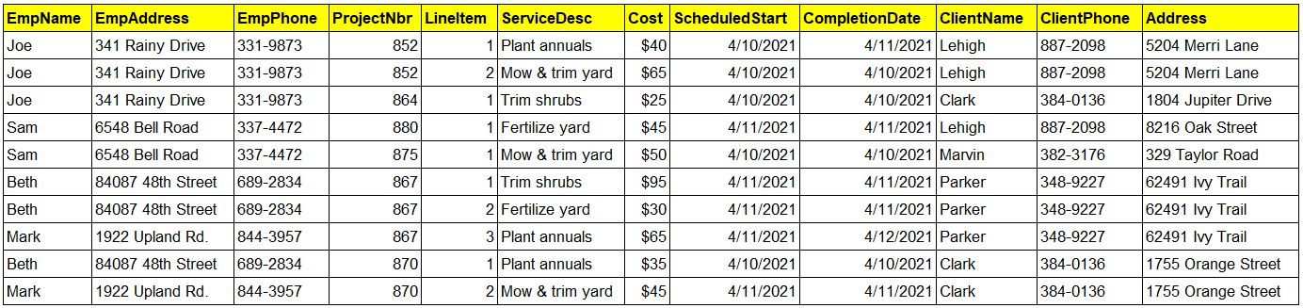
Conceptual model – bottom-up
Lawncare company example
Bottom-up approach
Use the data below to identify general tables needed

Slide 52
Break

Slide 53
Normalization

Slide 54
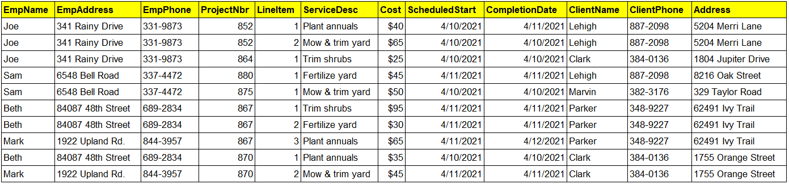
Normalization Example

Slide 55
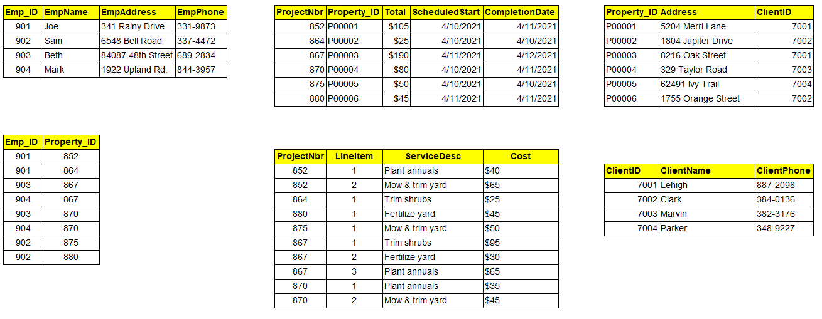
Normalization Example

Slide 56
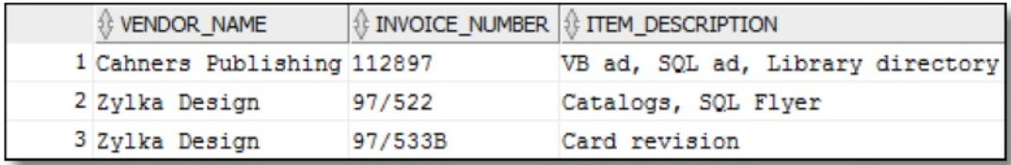

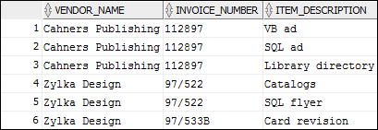
Non-normalized Data
Discussion Questions
How does this affect reads?
e.g. Count of products
e.g. Specific products
How does this affect adds
e.g. New product
How does this affect updates
e.g. Alter invoice items
How does this affect deletes
e.g. Delete invoice items
e.g. Delete invoice
Where is 1NF still an issue?
1NF = No repeating columns or multi-valued cells
Notes:
How does the first example handle anomalies? How does the second example restrict scaling your business process?

Slide 57
TIP: Let’s treat 2NF & 3NF the same

Slide 60
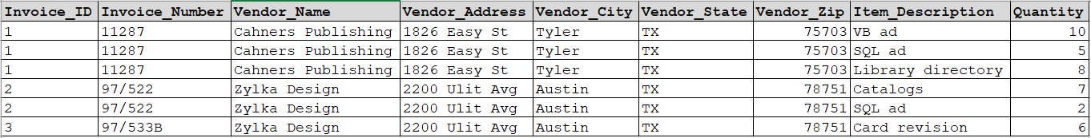
1NF = No repeating columns or multi-valued cells
Simple normalization tip: Where do you see unnecessary duplication?

Slide 61
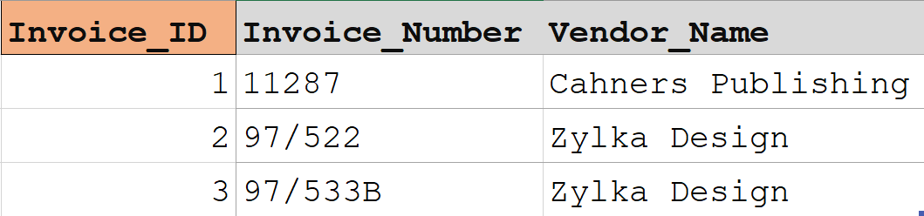
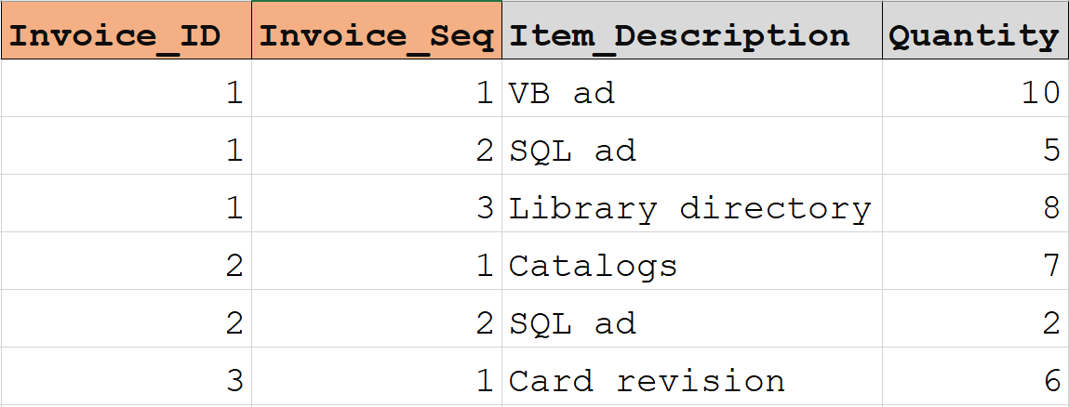
2NF = Non Key columns are dependent on the Composite PK
Questions:
1. Where is there unwanted redundancy in non-key columns?
2. Ask if the non-key column is dependent on the table’s PK (another way to think about it. Does the non-key value get determined based on the table’s PK?)

Slide 63
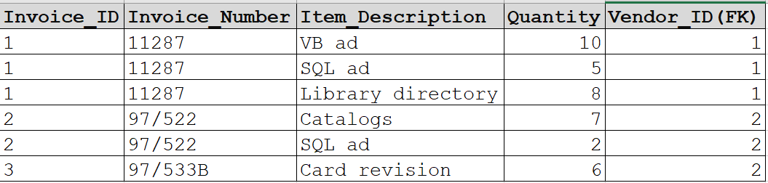
3NF = Non Key columns are dependent on singular PK
Questions:
1. Where is there redundancy in non-key columns?
2. Ask if the non-key column is dependent on the table’s PK (another way to think about it. Does the non-key value get determined based on the table’s PK?)
3. Are their columns that can be derived (or calculated) from other fields?
Take-away
Keep splitting tables until there is no unwanted redundancy on non-key columns

Slide 64
PRO TIP: Normalizing a table WITH data in excel can help!

Slide 65
When to “denormalize”
When a column from a joined table is used repeatedly in search criteria (e.g. city, state, and zip), may be easier and faster to keep it in a single table – Let’s review example
If a table is updated infrequently
Include columns with derived values when those values are used frequently in search conditions. (e.g. invoice balance)
NOTE: You don’t have to “over-normalize” and then “de-normalize”

Slide 66
Practice
Step 1: Identify and list all data elements
Step 2: Subdivide each element into its smallest useful components
Step 3: Identify the tables and assign columns *
Step 4: Identify the primary and foreign keys *
Step 5: Review whether the data structure is normalized

Slide 67
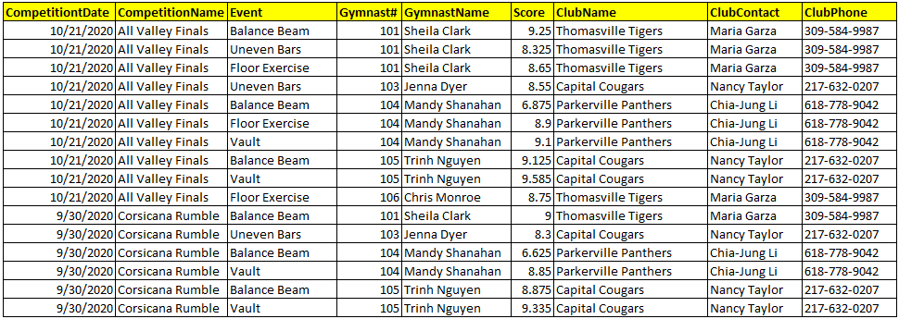
Practice

Slide 68

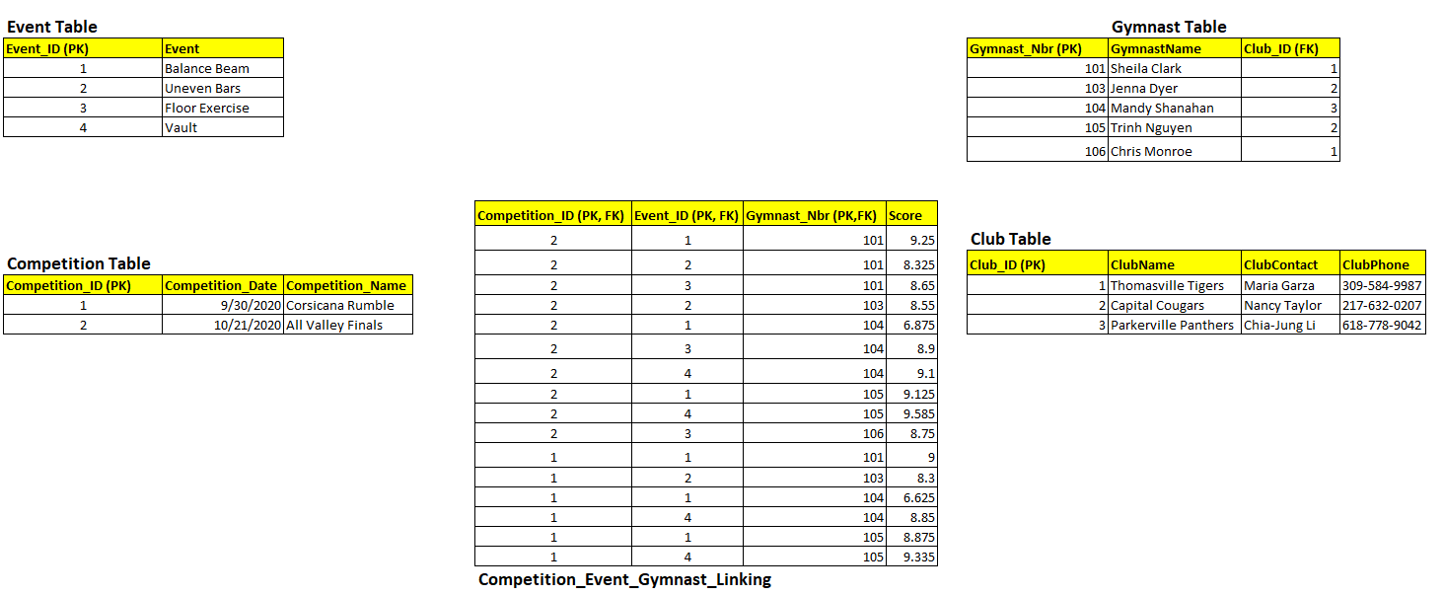
Possible solution

Slide 69
Up Next
Homework 2 - ERD
Create an MVP of a rideshare system
Normalize the model to be around 7-9 tables.
Avoid overly normalizing it
This will feed into the next assignment on DDL and DML
Prepare for next class
Log into database and start playing around
Look at reference materials
Look at videos
Be ready to have to write/run DDL and basic DML in class next week

Slide 70
Questions?

